Slide 1
Colorectal Cancer Screening

Slide 2
Why is colorectal cancer screening performed?
The primary goal of colorectal cancer screening is to identify polyps and remove them before they become malignant.
This helps to stop colorectal cancer before it starts to develop, increasing the chance of a successful treatment.

Slide 3
Who should be screened for colorectal cancer?
Men and women age of 50 and above.
People who are at risk should be screened before age 50.
People of African American or Eastern European ancestry
Those with personal history of colorectal cancer, polyps, and inflammatory bowel diseases
Those with a family history of colorectal cancer or polyps, hereditary colorectal cancer syndromes
Those who smoke cigarettes, drink alcohol and consume a high-fat, low-fiber diet

Slide 4
How is colorectal cancer screening performed?
Colorectal cancer screening is performed through different types of tests including:
CT colonography (CTC) /(virtual colonoscopy) - Performed every five years
Colonoscopy - Performed every 10 years
Double-contrast barium enema - Performed every 5 years.
Flexible sigmoidoscopy - Performed every 5 years
Fecal occult blood test (FOBT) or fecal immunochemical test (FIT) - Performed every year
Stool DNA test - Performed every three years

Slide 5
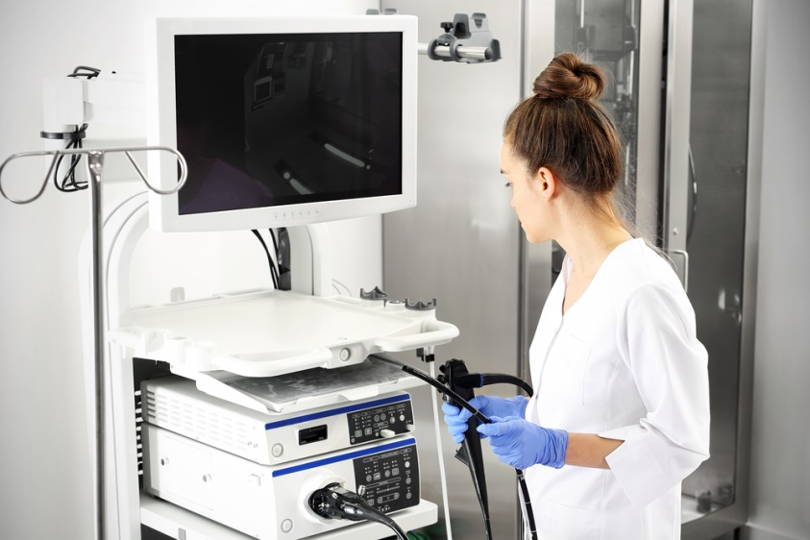
What happens if something is detected?
If blood, polyps or other suspicious areas are detected during screening (other than colonoscopy) your doctor will most likely recommend a follow-up colonoscopy.
If polyps are found during a colonoscopy, a biopsy or polypectomy may be performed to determine if it is malignant.

Slide 6
Contact Polymedco CDP, LLC
Polymedco CDP, LLC is a world leader in fecal occult blood screening technology.
888-638-7757
tpucci@polymedco.com

